Slide 1


Paraphrase Detection using Transformers and Graphs
Directed Study Milestone
April 2024
Nanda Kishore Kappaganthula
Supervision: Dr. Dan Lizotte

Slide 2


INTRODUCTION
In NLP, Paraphrase Detection ascertains whether two text segments express the same idea.
Challenges with current methods: Minor semantic nuances and contextual variances are difficult to capture.
The suggested methodology combines transformer-based sequence categorization with graph attention networks.
Objective: Improve the model's capacity to extract contextual and semantic relationships.

Slide 3
Key Findings
Unique architecture: Combining transformer-based models with graph attention approaches results in a unique architecture.
Gains in performance: MRPC dataset extensive trials demonstrate superiority above baseline approaches.
Implications: Transformer-based models may perform better in NLP tasks, particularly when it comes to paraphrase identification.
In summary, graph attention improves the model's ability to capture semantic links.

Slide 4
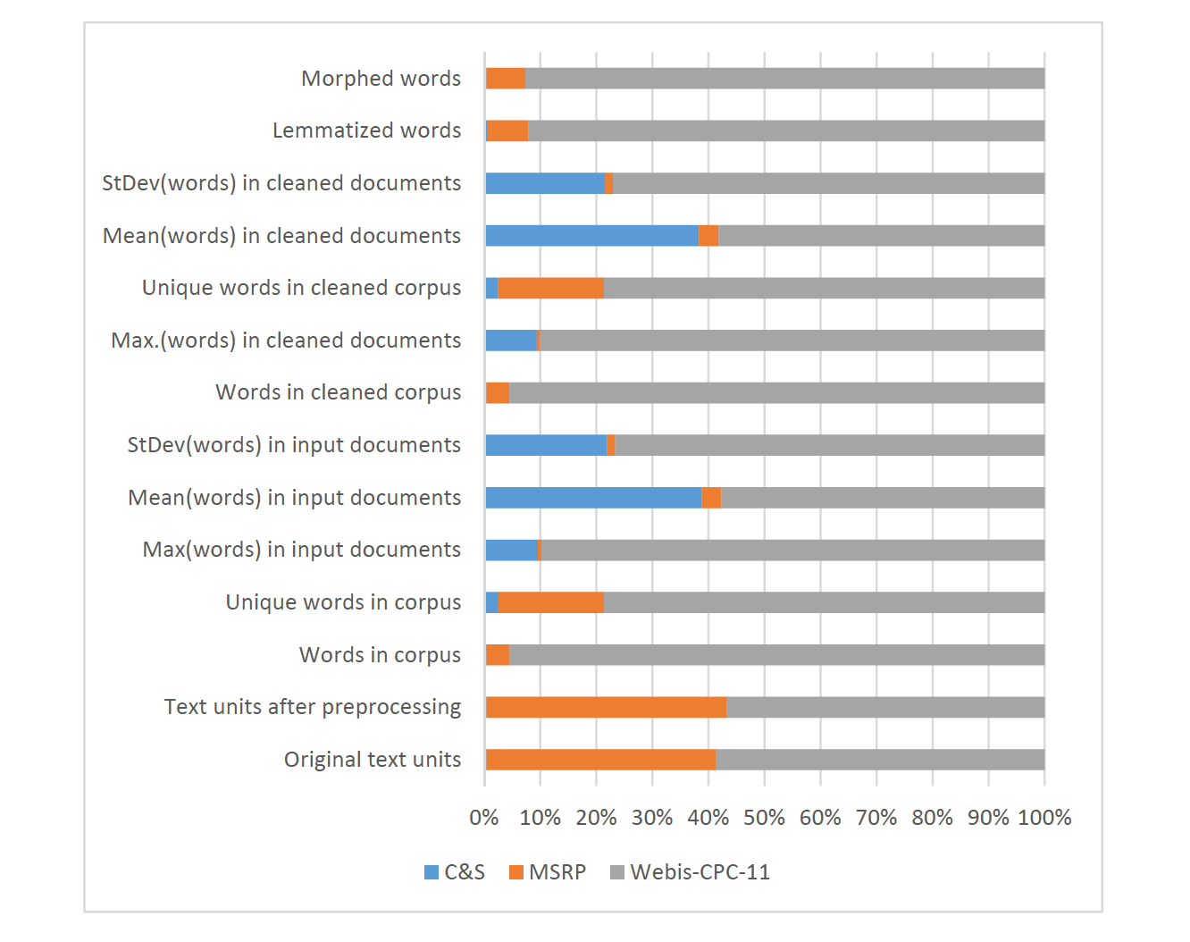
Corpus-Based Paraphrase Detection Experiments and Review (Tedo Vrbanec and Ana Meštrovi´c)
Focus: Deep learning (DL) models are prioritized in the evaluation of eight paraphrase detection methods based on corpora.
Corpora Used: Webis Crowd Paraphrase Corpus 2011, Microsoft Research Paraphrase Corpus, Clough and Stevenson.
Goal: Establish effective techniques for text pre-processing, semantic similarity thresholds, distance measurements, and sub-model selection.
Examined models include GloVe, FastText, LSI, TF-IDF, Word2Vec, Doc2Vec, and USE.
Performance Evaluation: Traditional methods are not as effective as DL models.
Applications: Essential for NLP applications such as text mining, authorship attribution, question answering, and text summarization.
Problems: Currently available paraphrase algorithms have trouble with semantic subtleties and noisy data.

Slide 5
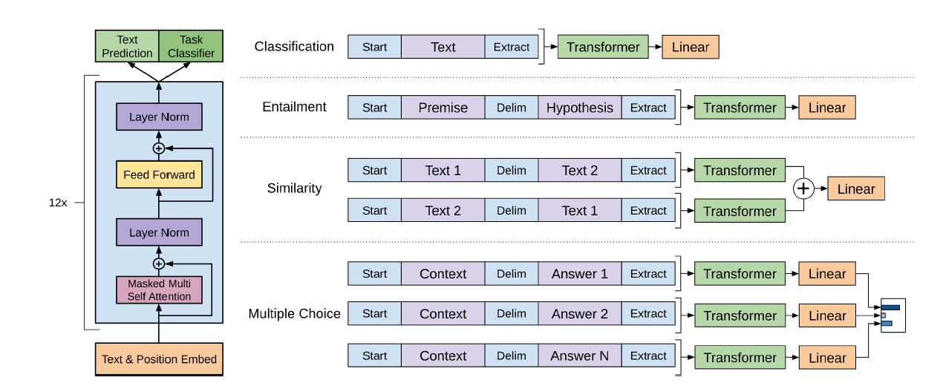
Improving Language Understanding by Generative Pre-Training (Alec Radford, Karthik Narasimhan, Tim Salimans, Ilya Sutskever)
Method: Presents a revolutionary technique to NLP called Generative Pre-Training (GPT).
Goal: Through unsupervised pre-training, improve performance on language comprehension tests.
Architecture: Includes 12 attention heads, 12-layer Transformer decoder models, and feed-forward blocks with 3072-dimensional layers.
Unsupervised Pre-Training: From unlabeled text, the model picks up intricate language connections and patterns.
Fine-Tuning: After unsupervised pre-training, certain tasks are subjected to supervised fine-tuning.
Performance: On nine of the twelve NLP tasks (textual entailment, question answering, and common-sense reasoning) it outperforms state-of-the-art models.
Impact: Advances NLP more quickly and lays the groundwork for upcoming models.

Slide 6
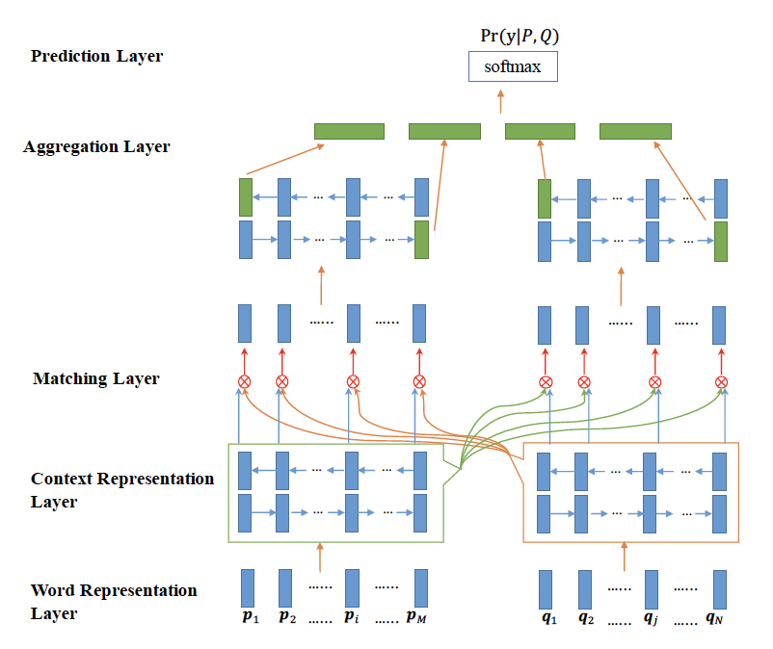
Bilateral Multi-Perspective Matching for Natural Language Sentences (ZhiguoWang, Wael Hamza, Radu Florian)
Method: The BiMPM (Bilateral Multi-Perspective Matching) model for matching sentences in natural language is introduced.
Goal: Handle the issue of natural language sentence matching, which is necessary for jobs like answering sentence selection, natural language inference, and paraphrase identification.
Framework: Functions according to the "matching-aggregation" paradigm, utilizing a BiLSTM encoder to encode two words, matching them bidirectionally from various angles, and combining the outcomes into a fixed-length matching vector.
NLP advancements: Notable breakthroughs in paraphrasing detection and sentence matching.
The BiMPM Model: Its multi-perspective approach and bilateral matching outperform earlier techniques in terms of accuracy and robustness.
Impact: Offers state-of-the-art sentence matching techniques and establishes benchmark datasets with cutting-edge findings.
Conclusion: Shows how crucial it is to use multi-perspective matching techniques and pre-training on huge corpora in order to advance NLP research and solve real-world issues.

Slide 7
Problem Description
Goal: Ascertain whether two passages of text express the same idea.
Significance: Essential for assignments such as answering questions and summarizing texts.
Difficulty: There are difficulties due to minute semantic variations between sentences.
Conventional Methods: Frequently depend on language rules and manual feature engineering.
Limitations: Sentences may not reflect subtle commonalities between them in an efficient manner.
Proposed Approach: The suggested method combines graph attention mechanisms with transformer-based models.
Technique: To capture fine-grained semantic linkages and global contextual information, deep learning and attention techniques are used.
Objective: Boost the efficiency and precision of systems for detecting paraphrases.

Slide 8
Model Architecture
Components: Transformer-based sequence classification model and graph attention method.
Transformer Model: Encodes sentence pairs and extracts contextual representations by using BERT (Bidirectional Encoder Representations from Transformers).
Pre-training: Hugging Face Transformers library's "bert-base-uncased" version of the BERT model was loaded and pre-trained on a sizable text corpus.
Graph Attention Layer: a specially designed layer used to integrate graph attention methods into the model.
Attention Computation: To ensure proper attention distribution, the GraphAttention layer computes attention weights based on learnt representations of input tokens.
Integration: The entire architecture is represented by the integration of the transformer model, graph attention layer, and classification components into the HybridModel class.

Slide 9
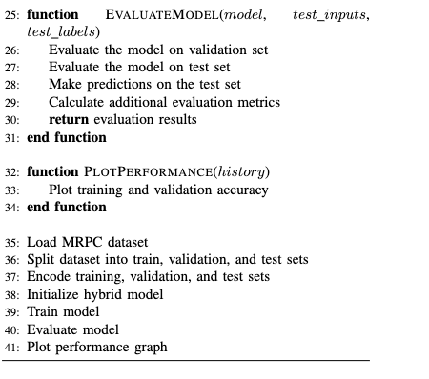
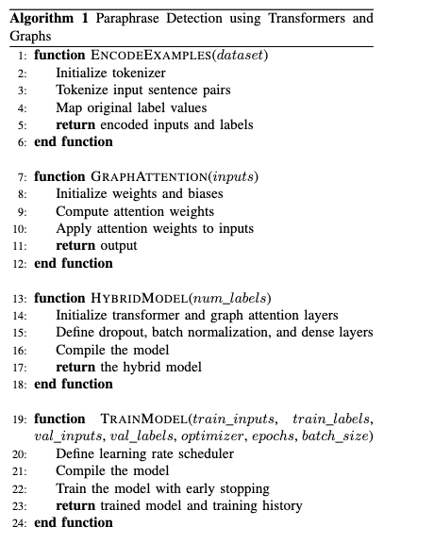
Algorithm

Slide 10
Model Functionality
HybridModel Class: Contains transformer model, graph attention layer, and classification components.
Processing Flow: The transformer model processes the input sequences, and then the graph attention mechanism refines them.
Classification: Dense layers are used to route refined representations for categorization.
Objective: The goal is to create valuable representations by capturing the fine-grained semantic relationships that exist between tokens and global contextual data.
Purpose: Enhance paraphrase detection by effectively capturing semantic similarities between sentence pairs.

Slide 11
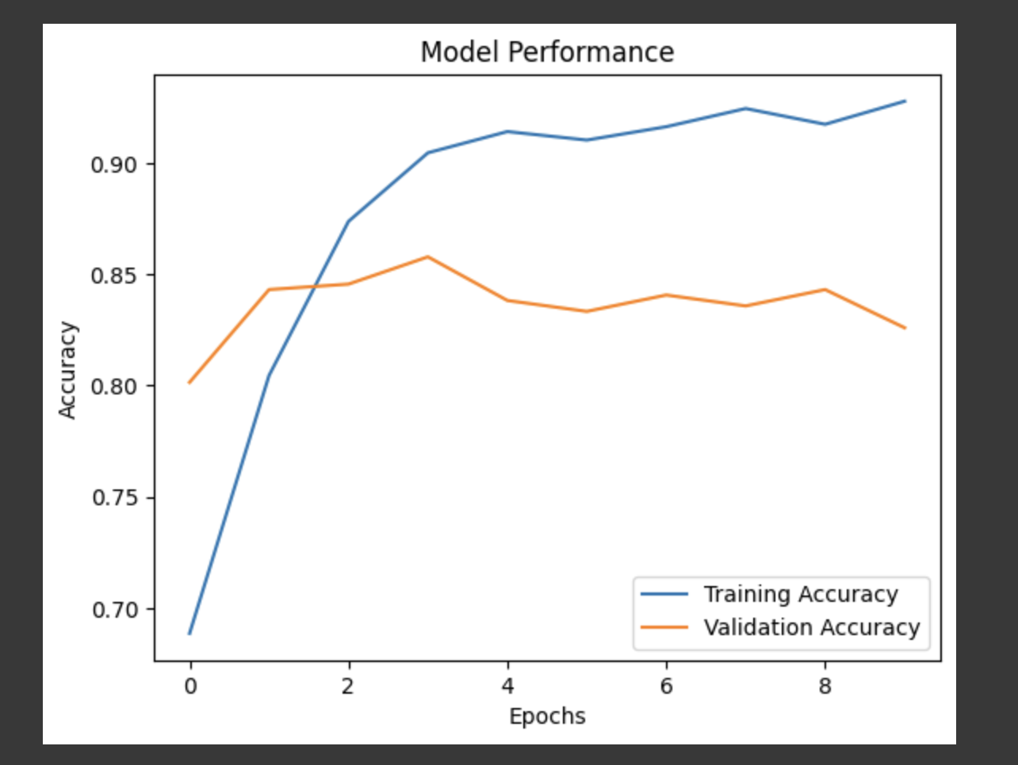
Performance Evaluation
Dataset: MRPC from GLUE benchmark used for training and validation.
Model Evaluation: Performance assessment and efficacy in paraphrase detection.
Insights: Examination of model effectiveness, misclassifications, dataset features, model architecture, and optimization strategies.
Validation Accuracy: 0.825
Test Accuracy: 0.8145
Precision: 0.798
Recall: 0.965
F1 Score: 0.873
Confusion Matrix: [[298 280] [40 1107]]

Slide 12
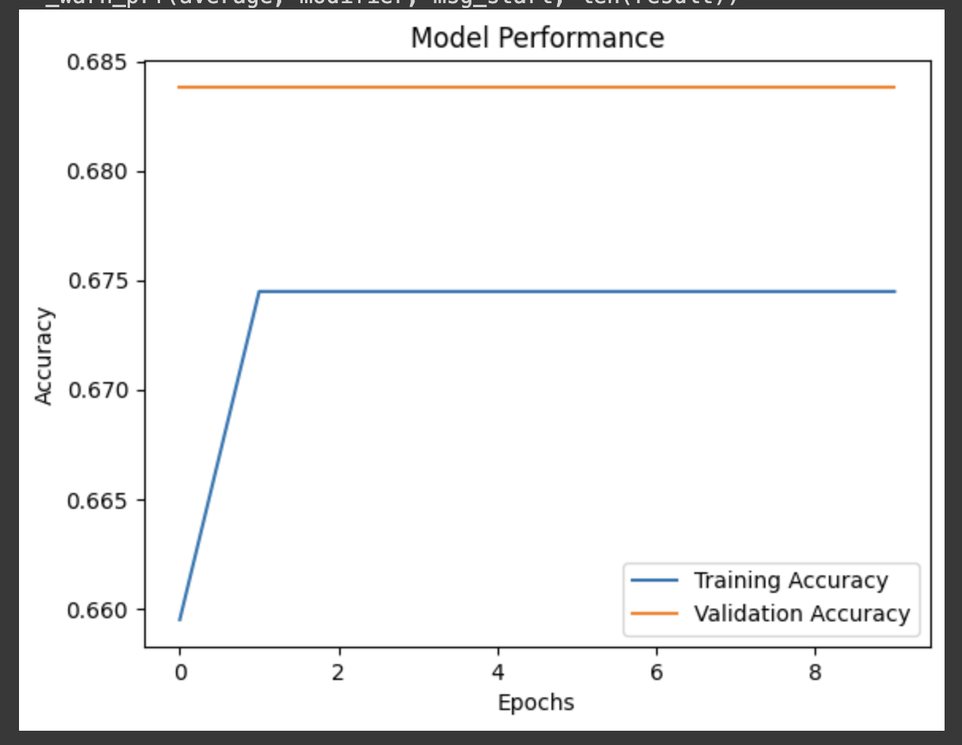
Contrast with baseline techniques
Advantages: Outperformance of previous methods, contextual information collection, and explicit semantic similarity identification.
Validation Accuracy: 0.683
Test Accuracy: 0.664
Precision: 0.664
Recall: 1
F1 Score: 0.798
Confusion Matrix: [[0 578] [0 1147]]
Promise: Potential of hybrid models to advance natural language understanding and further NLP-based paraphrase identification.

Slide 13
Conclusion
Dataset: For training and validation, MRPC from the GLUE benchmark is utilized.
Achievement: The model's ability to distinguish between paraphrases and non-paraphrases is demonstrated.
Impact: Enhancement of natural language comprehension and advancement of NLP-based paraphrase identification state-of-the-art.
Success of Hybrid Model: Emphasize how transformer and graph-based techniques work well together.
Model Performance: Highlight the high level of accuracy on benchmark datasets and the comprehensive analysis that classification reports offer.
The Promise of Hybrid Models: Discuss about how hybrid models could advance NLP tasks and natural language comprehension.

Slide 14
Future Work
Multimodal Paraphrase Identification:
Combine text with visuals, audio, or knowledge graphs.
Improve the efficiency of the model and capture more detailed semantic representations.
Domain Adaptation and Transfer Learning:
Improve model generalization for specialized domains like biomedical text or legal papers.
Semantic Understanding and Reasoning:
Improve the models' sensitivity to nuances in semantic relationships.
When working on complicated tasks, combine reasoning with knowledge representation.

Slide 15
Future Work
Ethical and Social Implications:
Ensure fairness and transparency while addressing biases.
Address security and privacy issues with NLP systems.
User-Centric Design and Evaluation:
Undertake studies on usability in real-world scenarios.
Incorporate end users for iterative improvements.
Future Investigation Directions:
Provide more powerful and effective methods for understanding and producing natural language.
Advance NLP technology through exploration of new avenues.

Slide 16

THANK YOU!

